Slide 1
MOST POPULAR COMPONENTS IN SYNCFUSION
SANJAY KUMAR E
SF4637

Slide 2
List of Most Popular Components:
In SYNCFUSION, Most of the Popular Components are :
DataGrid,
Chart,
List View,
Scheduler,
Diagram,
PDF Reader,
Excel Library.

Slide 3
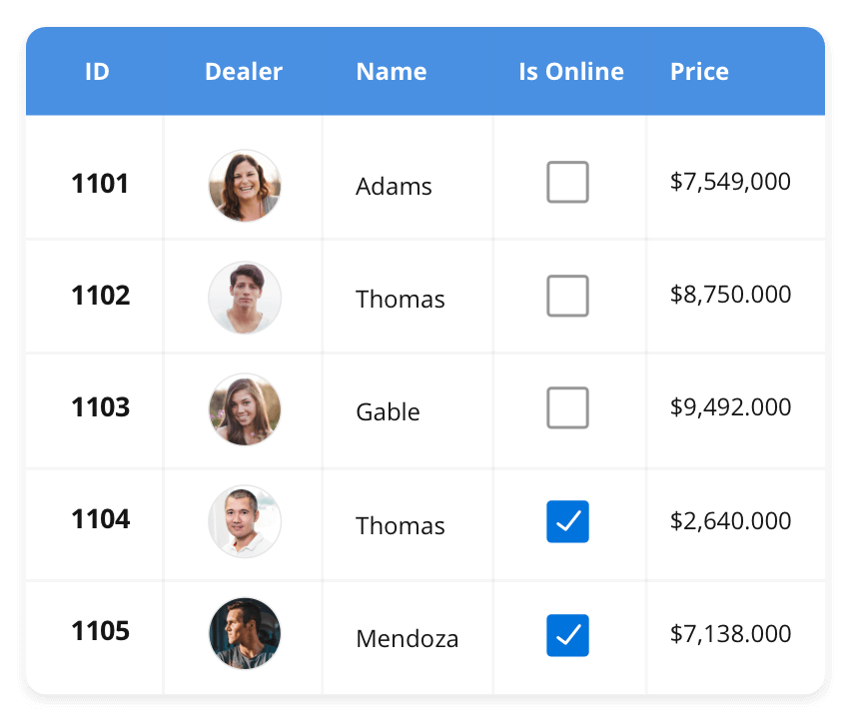


DATA GRID
DataGrid
The DataGrid control is a high-performance grid component that helps display and manipulate large amounts of data in a tabular format. Its rich feature set includes functionalities like data binding, sorting, grouping, editing, filtering, swiping, dragging, resizing, loading more items, pull-to-refresh, and exporting to Excel and PDF file formats.
SUPPORTED PLATFORMS
Vue
Java script
Flutter
Angular
ASP.NET MVC
React
ASP.NET CORE
Win Forms
UWP
WPF
.NET MAUI
WinUI
Flutter
Xamarin
Xamarin
Flutter
UWP
Java script
.NET MAUI

Slide 4
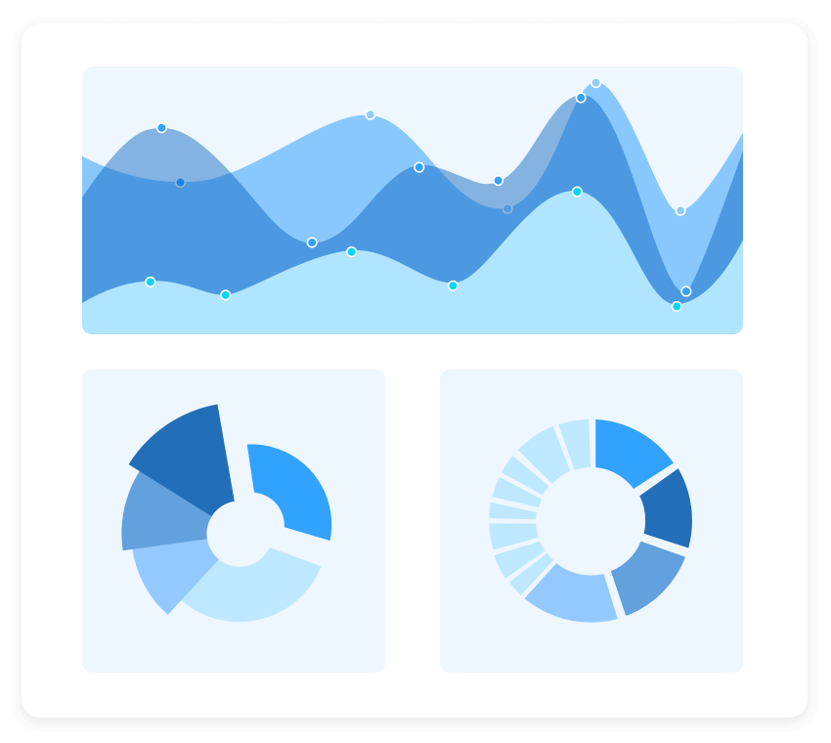
CHART
Charts
The Charts control can plot a wide range of chart types, ranging from line charts to specialized financial charts. Its rich feature set includes functionalities like data binding, multiple axes, legends, animation, data labels, annotations, trackballs, tooltips, and zooming.
SUPPORTED PLATFORMS
Java script
Flutter
Angular
ASP.NET MVC
React
ASP.NET CORE
Vue
Win Forms
UWP
WPF
.NET MAUI
WinUI
Flutter
Xamarin
Xamarin
Flutter
UWP
Java script
.NET MAUI

Slide 5
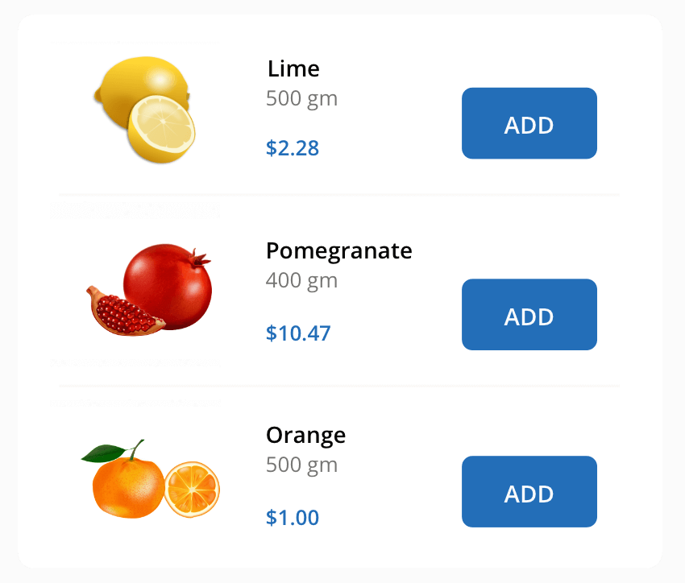
LISTVIEW
ListView
The ListView renders a set of data items with UI views or custom templates. It has many features like grouping, sorting, filtering, paging, swiping, multiple selection, drag and drop, and different layout types. The ListView control has been optimized to work with large amounts of data.
SUPPORTED PLATFORMS
Java script
Flutter
Angular
ASP.NET MVC
React
ASP.NET CORE
Vue
Win Forms
UWP
WPF
.NET MAUI
WinUI
Flutter
UWP
Java script
.NET MAUI
Xamarin
Flutter
UWP
Java script

Slide 6
Java script | Angular | React | Vue | Blazor
cxxc

